Slide 1
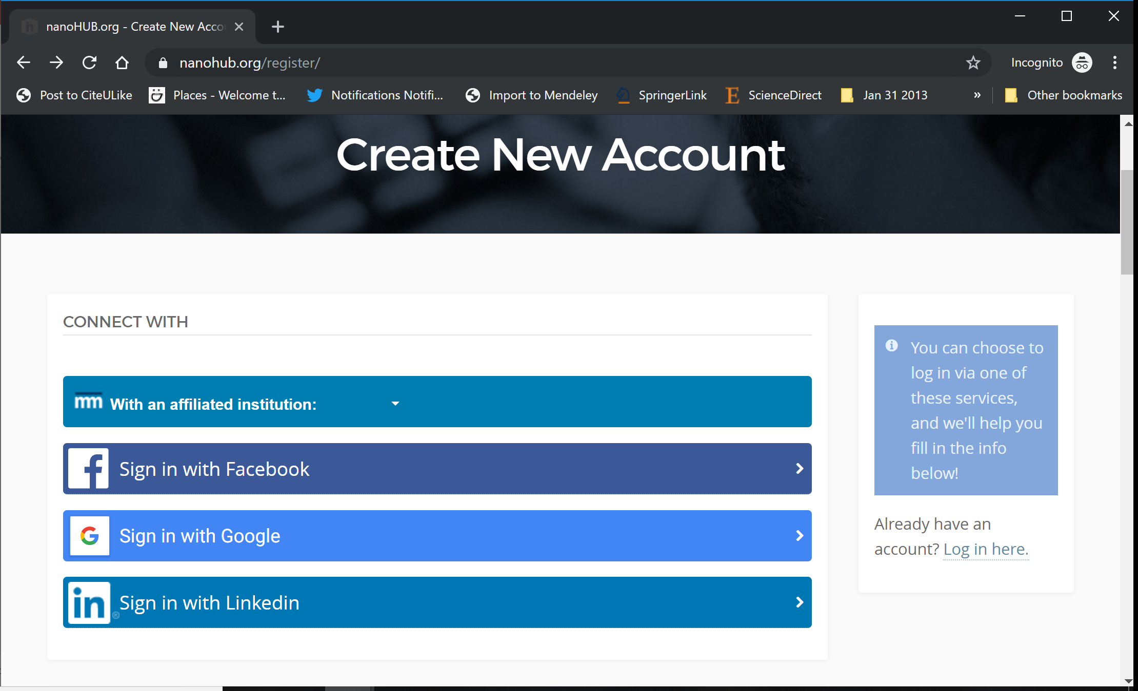
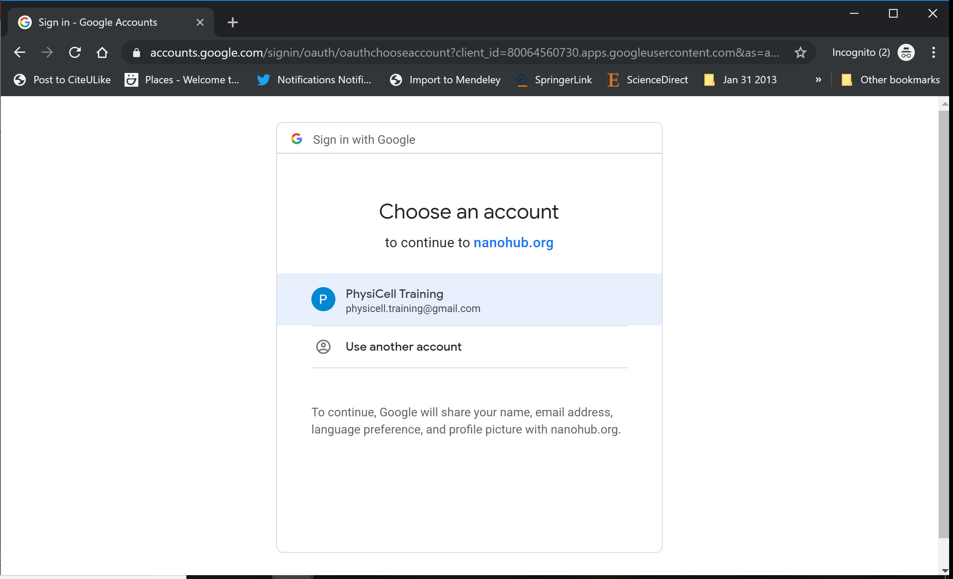
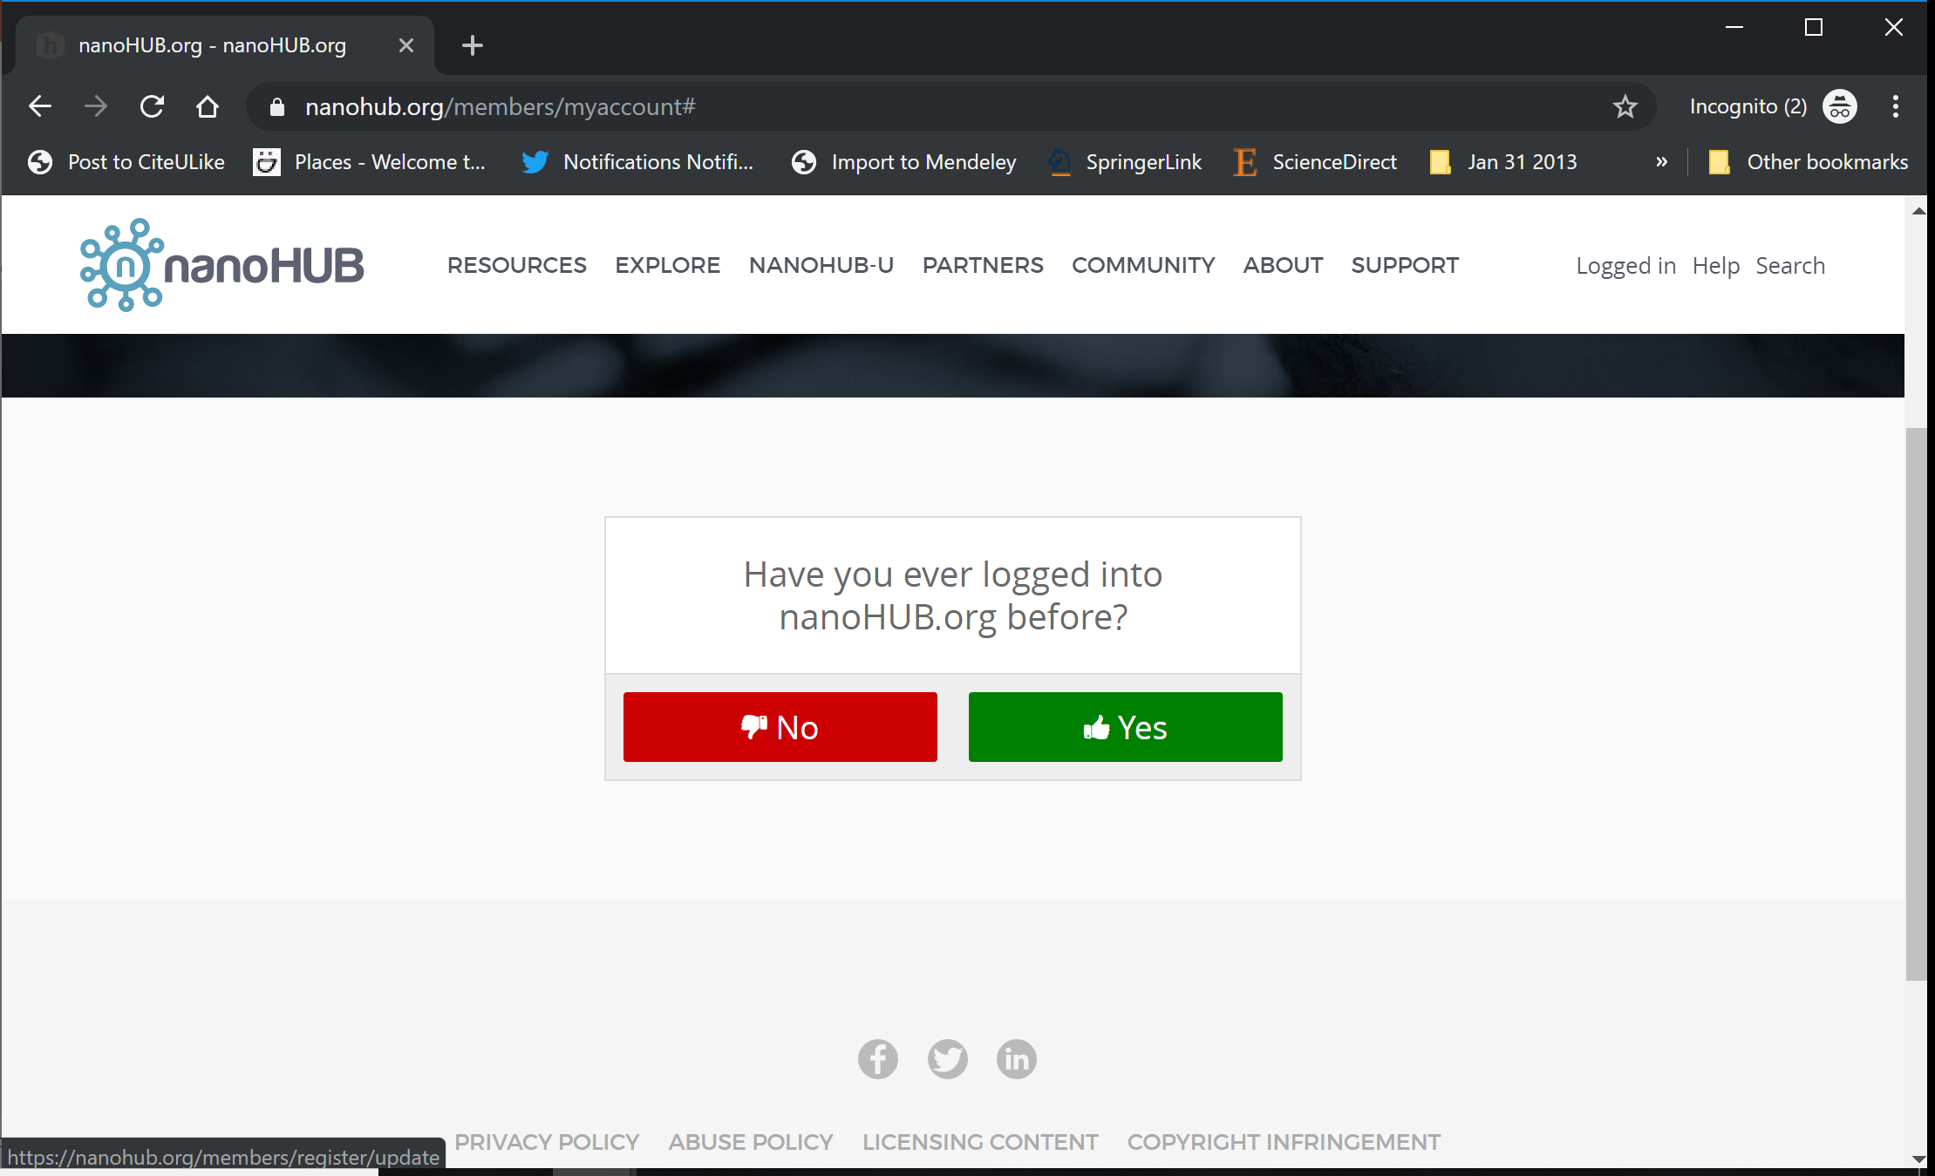
nanoHUB Account
This talk's online PhysiCell models are cloud-hosted on nanoHUB.org.
nanoHUB is free, but it requires a one-time registration.
Steps:
Visit https://nanohub.org/register
Choose "Sign in with Google"
Choose a Google account
Click "No" (so it doesn't try to associate with some other nanoHIB account)
Finish filling in details, and you're done!
Use your google account to sign in in the future.
2
3
4

Slide 2
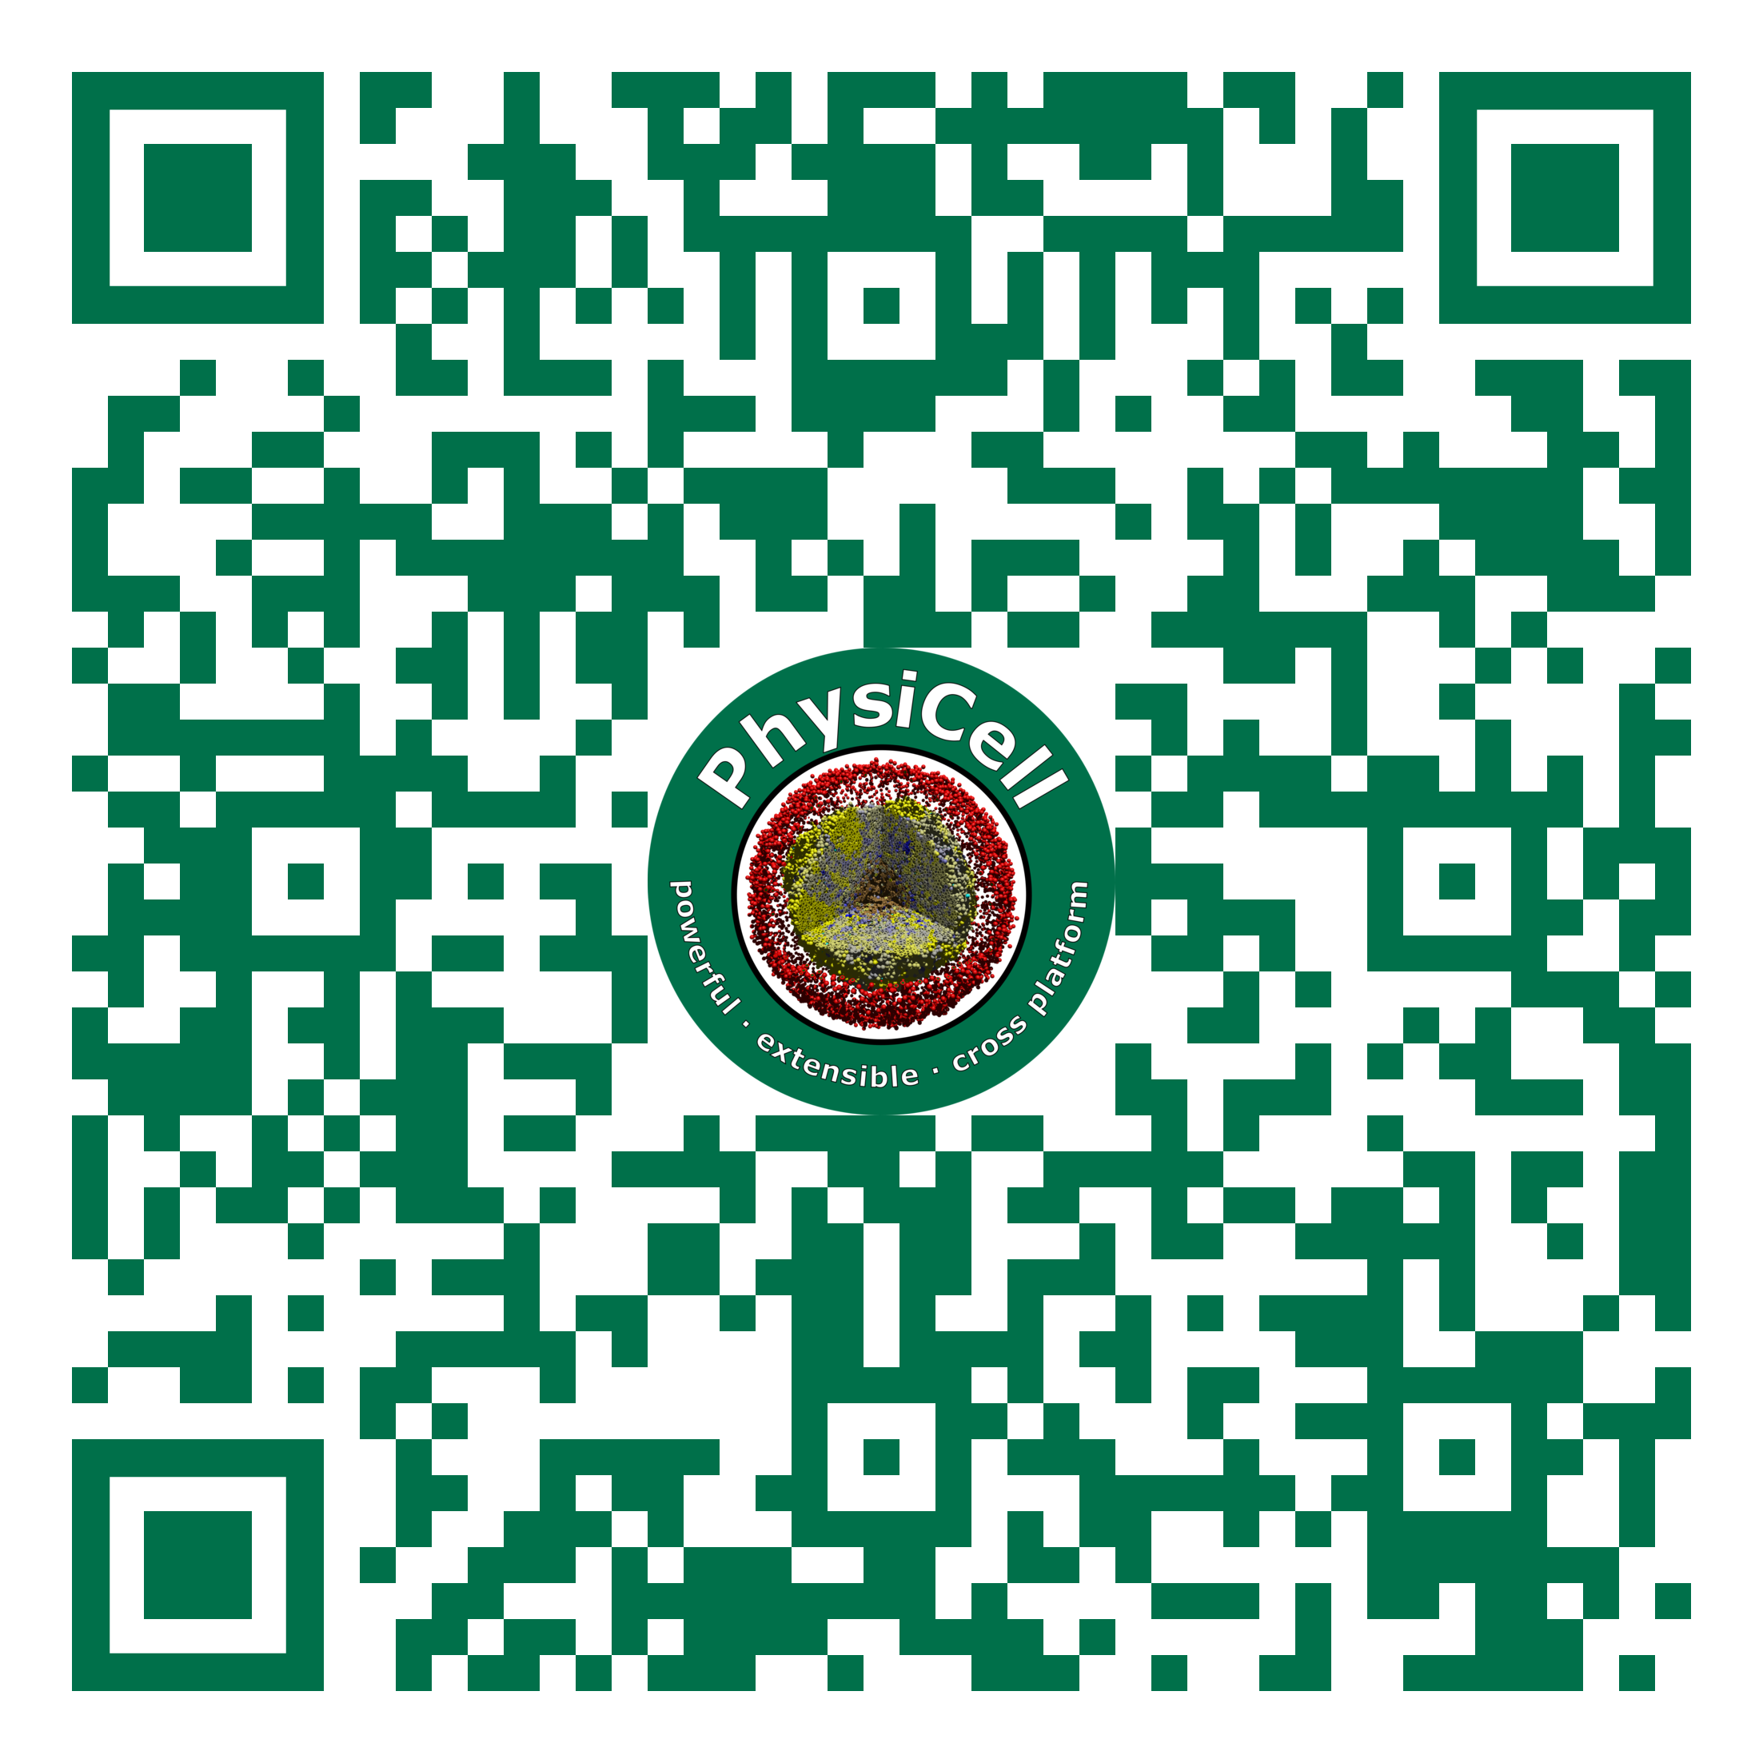
Introduction to agent-based modeling in biology: Part 1 (Python-based)
Lecture materials and code are available at:
[link]
Paul Macklin, Ph.D
February 16, 2021

Slide 3
Simple single-cell behaviors …
Growth
Division
Death
Adhesion
Mechanics
Motility
Secretion
Uptake
Sampling
Predation
Differentiation
…

Slide 4
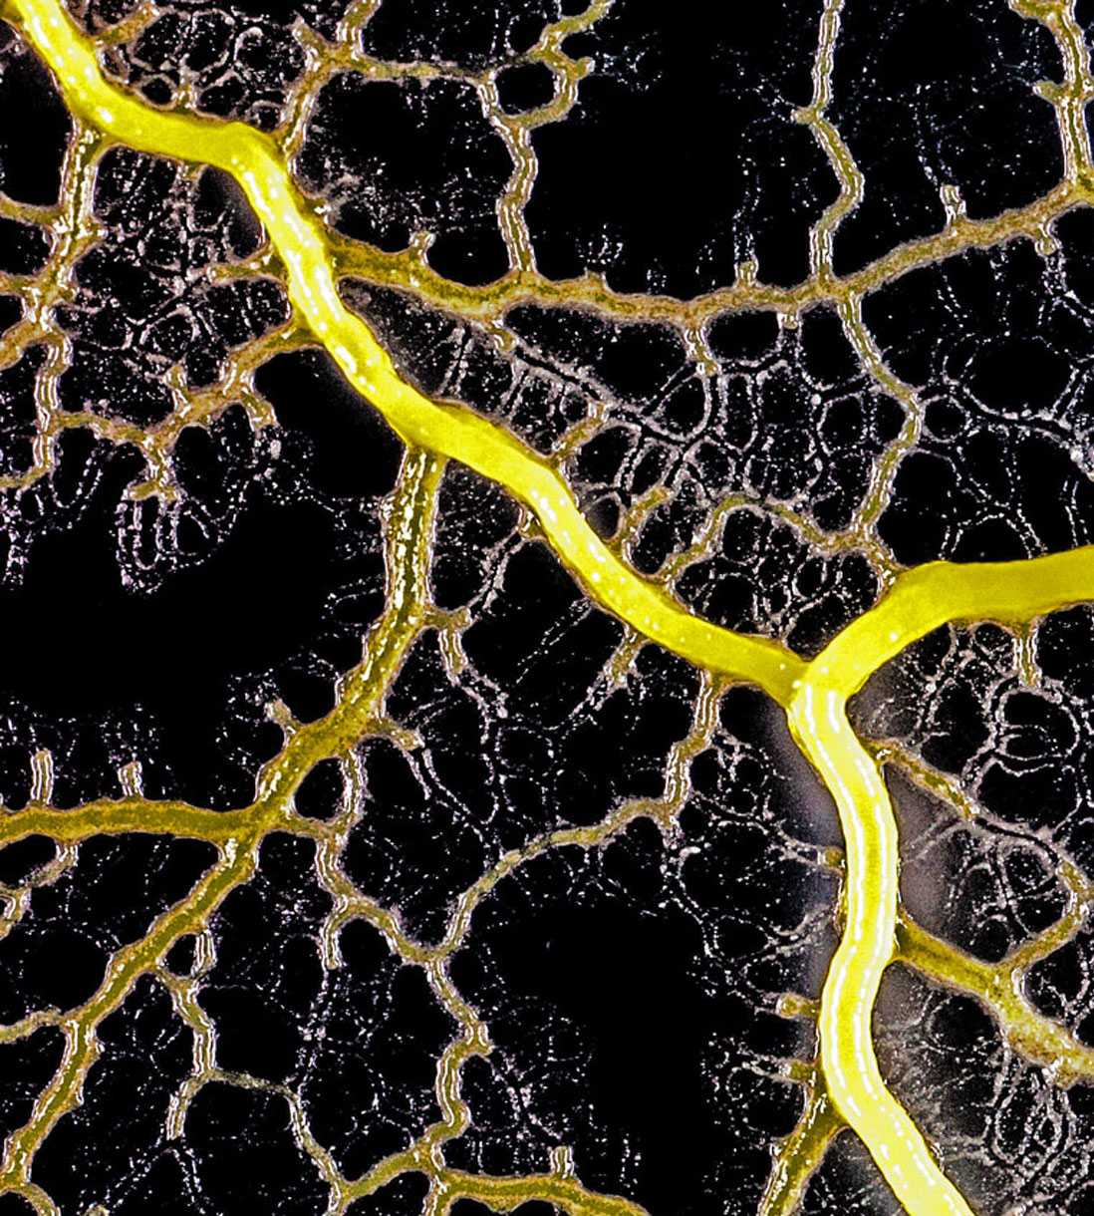
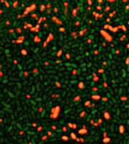
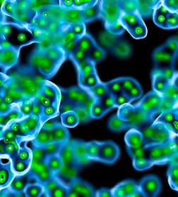
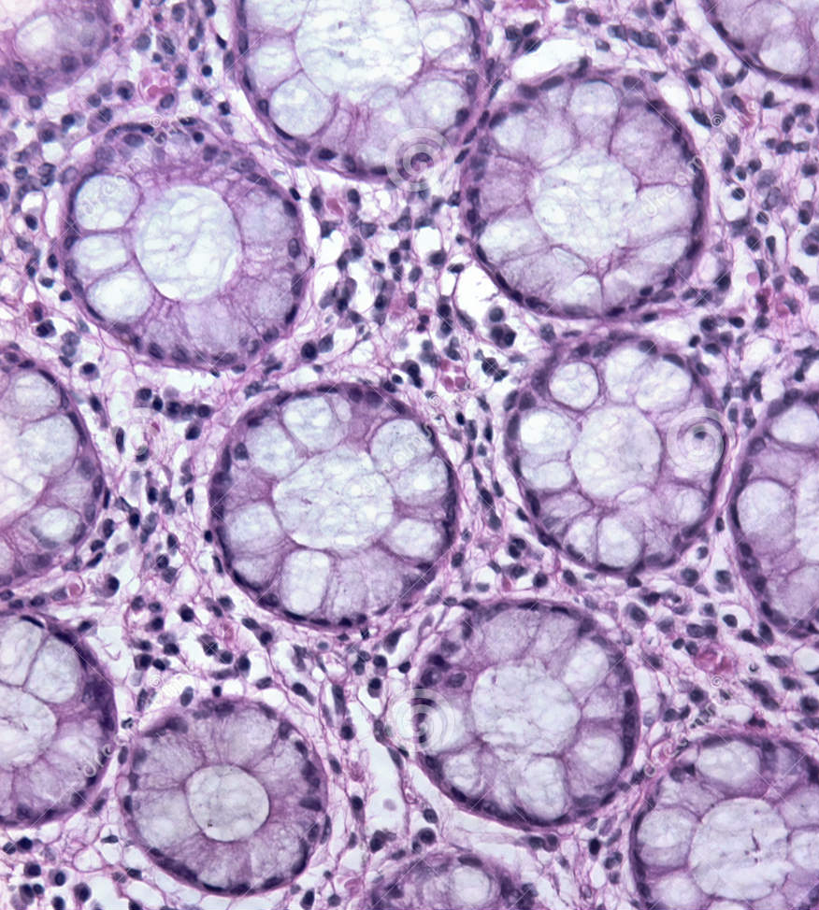
Give rise to complex systems
Multicellular systems—composed of multiple cells of multiple types—can exhibit remarkable diversity, with complex emergent behaviors.
How do these systems self-organize and sustain themselves?

Slide 5
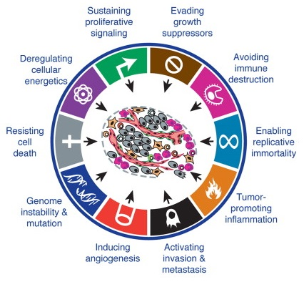
How do we understand these multiscale systems?
Interconnected systems and processes:
Single-cell behaviors
Cell-cell communication
Physics-imposed constraints (e.g., diffusion)
Systems of systems (e.g., immune system)
In diseases, these systems become dysregulated.
Treatments target parts of these systems.
Health is a complex system: changing one part can have surprising effects!
Modeling can help understand this system. This is multicellular systems biology.
If we can control these systems, we've arrived at multicellular systems engineering.
Source: Hanahan & Weinberg (2011)
DOI: 10.1016/j.cell.2011.02.013
Notes:
Tissues, including cancer, are complex, self-organizing systems.
Cancer is a complex system – treatments perturb this complex system, results can be surprising
Classic example: anti-angiogenic therapy
Mechanistic simulations can help us get new insights

Slide 6
Scientists use [models*] to detangle complex systems. * animal, in vitro, engineered, mathematical, …

Slide 7
Key parts of a multicellular virtual laboratory
Model multiple diffusing chemical factors
Growth substrates and metabolites
Signaling factors
Drugs
Model many cells in these chemical environments
Environment-dependent behavior (including molecular-scale "logic")
Mechanical interactions
Heterogeneity:
individual states
individual parameter values
individual model rules
Run many copies of the model in high throughput
Discover the rules that best match observations.
Identify and exploit weaknesses that can restore control

Slide 8
What is an agent-based model?
Each cell is modeled as a separate software object (an agent) with:
member data: internal state variables
Position, Size, Cycle State, molecular variables, ….
methods: cellular processes
Cycling, Death, Motility, Growth, Adhesion, …
Virtual cells move a virtual (micro)environment
Usually liquid (e.g., water or interstitial fluid)
Chemical movement (oxygen, glucose, signaling factors)
Typically diffusion: solve partial differential equations (PDEs)
May also require advection for environments with flow
May include mechanical components like extracellular matrix (ECM)
Finite element methods or related methods
environment
agents
cell
cell
cell

Slide 9
What's the connection to biology and physics?
The cell agents encode our biological knowledge and hypotheses:
Cell variables (member data) are selected to record important biological quantities
Volume, cell cycle state, energy, …
Cell rules (methods) encode biological hypotheses
Increase motility in low oxygen, down-regulate cycling under compression, …
Cell rules are often written at mathematical models
Potential functions for mechanics, systems of ODEs for metabolism, …
The microenvironment encodes physical constraints:
Chemical transport: diffusion and advection equations (PDEs)
Tissue mechanics: viscoelastic, plastoelastic or other solid mechanics
Most agent-based models combine discrete cell agents and continuum microenvironment processes. This is a hybrid continuum-discrete approach.
environment
agents
cell
cell
cell

Slide 10
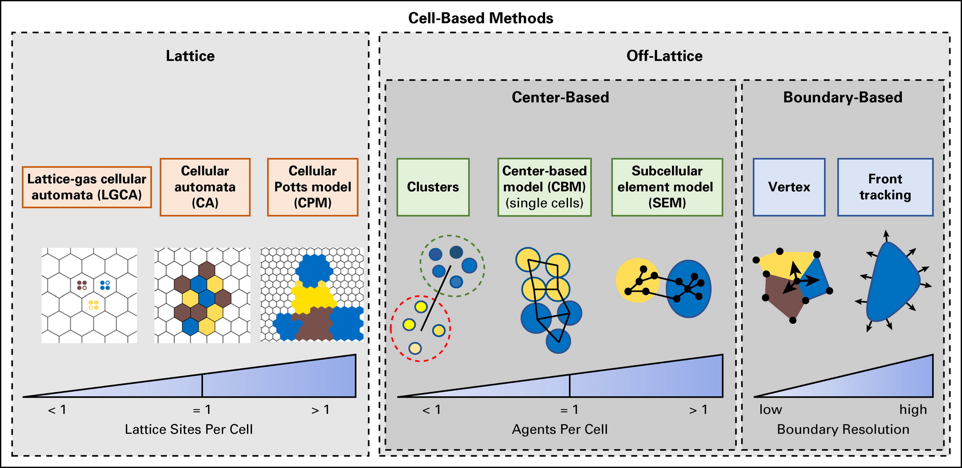
Types of cell-based models
lattice-bound
resolution:
< 1 site / cell:
lattice gas
1 site / cell
cellular automaton
many sites / cell
cellular Potts
off-lattice
center-based
boundary-based
J. Metzcar, Y. Wang, R. Heiland, and P. Macklin. A review of cell-based computational modeling in cancer biology. JCO Clinical Cancer Informatics 3:1-13, 2019 (invited review). DOI: 10.1200/CCI.18.00069.

Slide 11
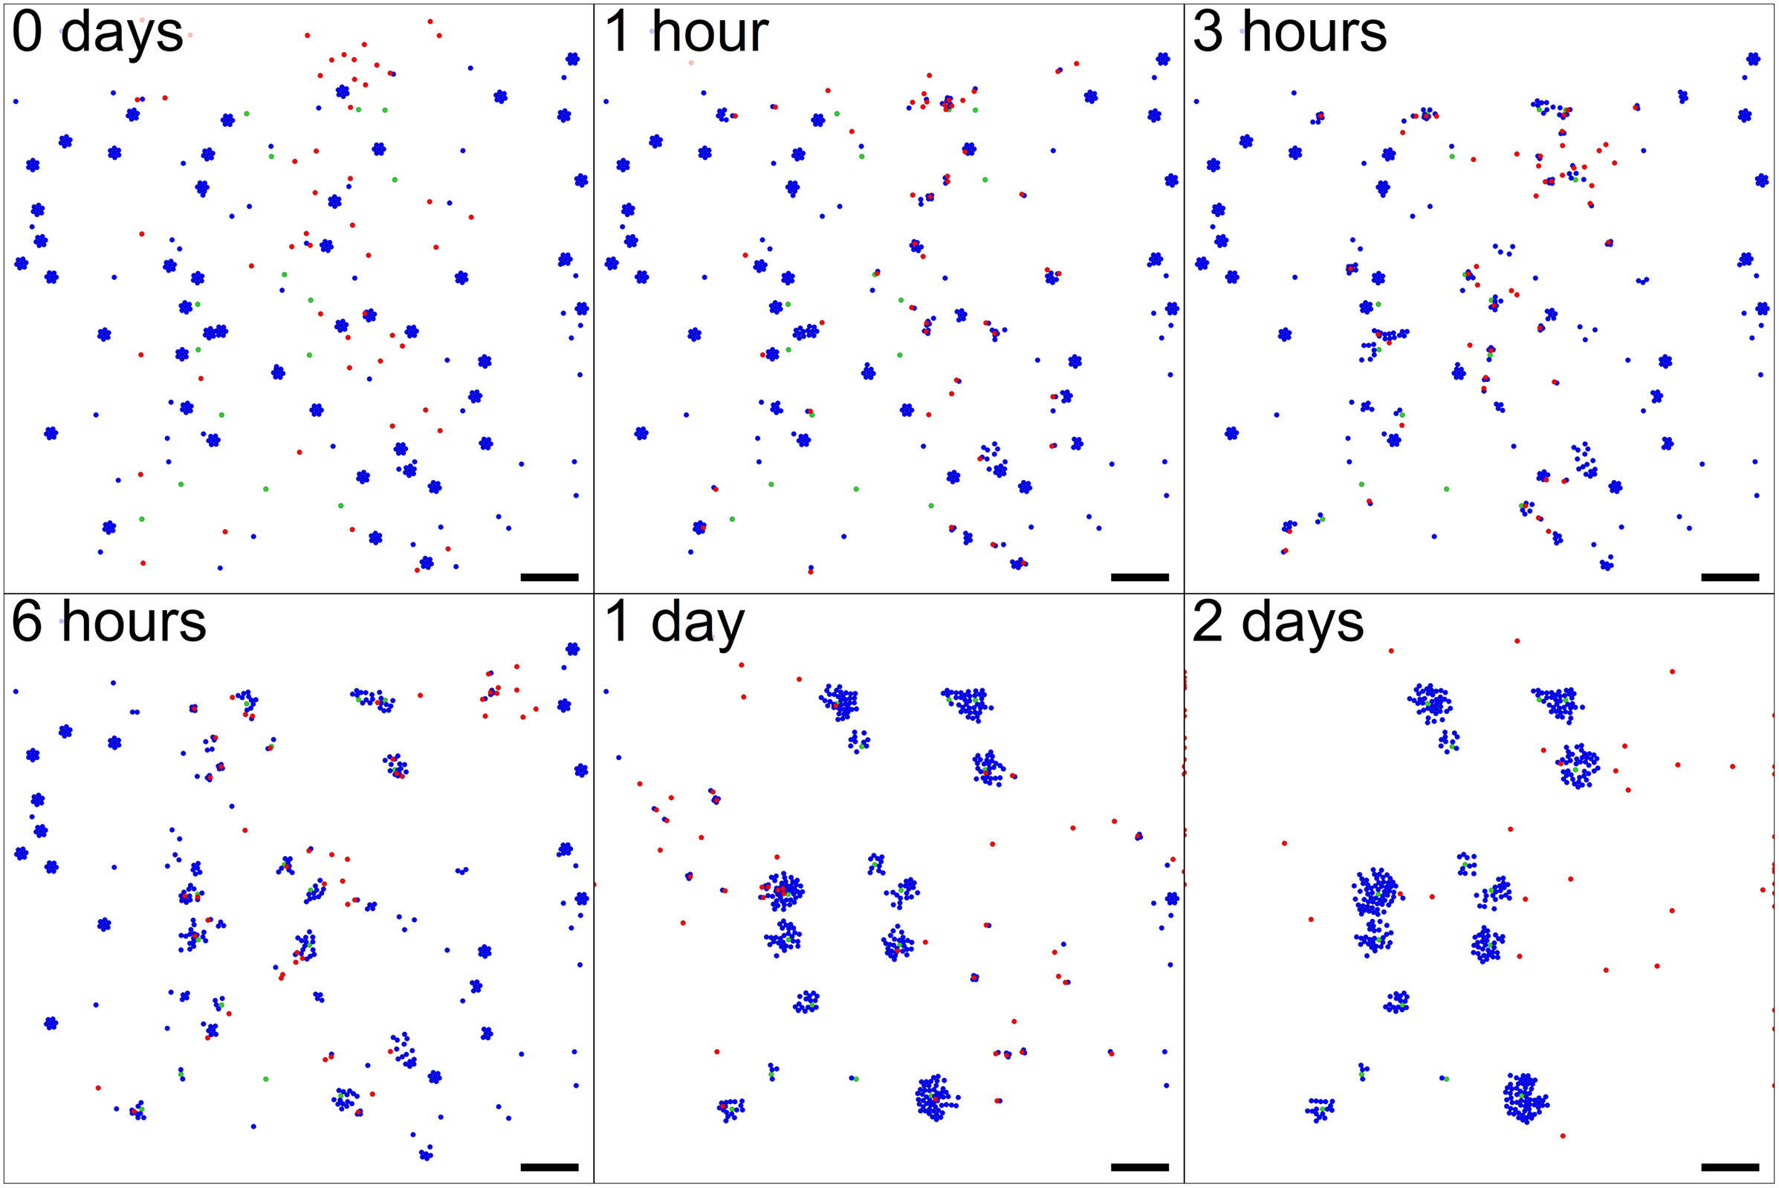

Example: biological cargo delivery system
Chemical environment:
two diffusing chemical signals
Cell types and rules:
directors (green):
secrete director signal to attract workers
cargo (blue):
undocked: secrete cargo signal to attract workers
docked: turn off signal
workers (red):
undocked: seek cargo via chemotaxis
docked: seek directors via chemotaxis, release cargo in high signal areas
Try this model yourself!
https://nanohub.org/tools/pc4biorobots

Slide 12
Typical program flow
Read parameters
Set up microenvironment
Create meshes, initialize chemical substrates, diffusion solvers, etc.
Set up cell agents
Define all cell types
Instantiate cells
For each time:
Update microenvironment
Solve reaction-diffusion equations (as needed)
Solve tissue mechanics (as needed)
Update each cell's state
Sample environment
Run signaling model (as needed)
Update behavioral parameters based on signaling model and sampled environment
Run cell process models (growth, cycling, death, …)
Calculate cell velocities
Update cell positions
Advance time

Slide 13
Let’s build an agent-based model in Python

Slide 14
Classes
A class is a template for creating a software object, including:
member data
initial values for its state (member variables)
member functions (or methods)
A class will generally have one or more constructors that are called when the class is instantiated.
Set default values for member data

Slide 15
A class declaration (Python)
class Agent:
def __init__( self ): # default constructor
self.hidden_variable = False; # no such thing as private in Python
self.position = [0,0];
self.hunger = 0.0;
self.ID = 0;
return;
def move_me( self , dx, dy ): # member function
self.position[0] += dx ;
self.position[1] += dy;
return;
def display( self ):
print( str(self.ID) + ' at ' + str(self.position) + ' has hunger level '
+ str(self.hunger) )
Bob = Agent();
Bob.ID = 1;
Bob.move_me( 1,-1);
Bob.display();
Go to the Lecture notebook (Section 1) to execute this code.

Slide 16
Loading key libraries
# Let’s load libraries
import numpy as np
import matplotlib.pyplot as plt
# set matplotlib to do plots inline
%matplotlib inline
Go to the Lecture notebook (Section 2) to execute this code.

Slide 17
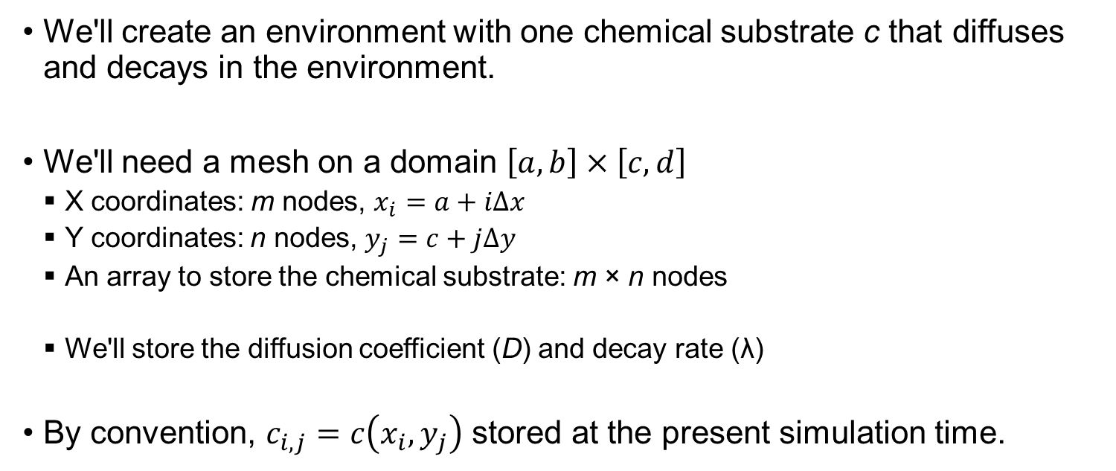
Creating an environment
We'll create an environment with one chemical substrate c that diffuses and decays in the environment.
We'll need a mesh on a domain $\left[a,b\right]×\left[c,d\right]$
X coordinates: m nodes, $x_{i}=a+iΔx$
Y coordinates: n nodes, $y_{j}=c+jΔy$
An array to store the chemical substrate: m × n nodes
We'll store the diffusion coefficient (D) and decay rate (λ)
By convention, $c_{i,j}=c\left(x_{i}, y_{j}\right)$ stored at the present simulation time.

Slide 18
Environment class (v1)
# Declare environment class
class Environment:
def __init__( self , shape=[-100,-100,100,100], m=2 , n=2 ):
self.a = shape[0]
self.b = shape[2]
self.c = shape[1]
self.d = shape[3]
self.m = m;
self.n = n;
self.dx = (self.b-self.a)/(m-1);
self.dy = (self.d-self.c)/(n-1);
self.X = np.linspace( self.a, self.b , m )
self.Y = np.linspace( self.c, self.d, n )
self.C = np.zeros((m,n));
return;
def setup( self , D=1000, decay=0.1 , initial=1.0, boundary=1.0 ):
self.D = D;
self.decay = decay; # In Python you can evidently declare more class elements in methods
# set boundary values
self.C = boundary * np.ones((self.m,self.n))
# set interior values to initial value
for j in range(1,self.n-1):
for i in range(1,self.m-1):
self.C[i,j] = initial ;
print( 'Length scale: ' + str( np.sqrt(self.D/self.decay) ) )
return;
Go to the Lecture notebook (Section 3) to execute this code.

Slide 19
Testing …
E = Environment( [-100,0,200,400] , 31,41 )
E.setup( 1000, 0.1 , 0.5 , 1 )
plt.contourf( E.X, E.Y, np.transpose( E.C ) )
plt.axis('image')
plt.colorbar()
Go to the Lecture notebook (Section 3) to execute this code.

Slide 20
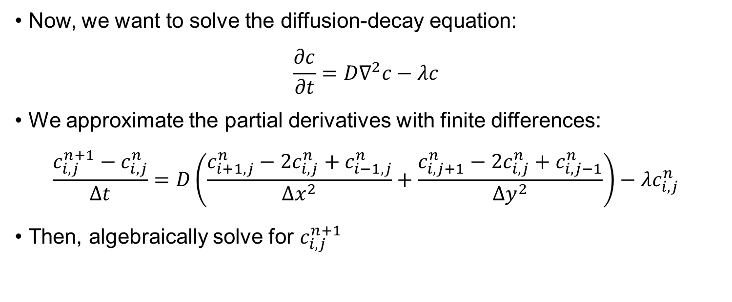
Adding diffusion and plotting
Now, we want to solve the diffusion-decay equation:
$$\frac{∂c}{∂t}=D∇^{2}c−λc$$
We approximate the partial derivatives with finite differences:
$$\frac{c_{i,j}^{n+1}−c_{i,j}^{n}}{Δt}=D\left(\frac{c_{i+1,j}^{n}−2c_{i,j}^{n}+c_{i−1,j}^{n}}{Δx^{2}}+\frac{c_{i,j+1}^{n}−2c_{i,j}^{n}+c_{i,j−1}^{n}}{Δy^{2}}\right)−λc_{i,j}^{n}$$
Then, algebraically solve for $c_{i,j}^{n+1}$

Slide 21
Environment class (v2)
# Declare environment class
class Environment:
# __init__ and setup as before
def update( self , dt=0.001 ):
# define constants for simplicity
A = self.D * dt / ( self.dx**2 )
B = self.D * dt / ( self.dy**2 )
C = self.decay * dt
# copy the prior solution.
old = self.C.copy(); # make sure this is a real copy and not a reference.
# finite differences for decay-diffusion
for i in range(1,self.m-1):
for j in range(1,self.n-1):
self.C[i,j] = (1-2*A-2*B-C)*old[i,j] + A*(old[i-1,j]+old[i+1,j])
+ B*( old[i,j-1]+old[i,j+1] );
return;
def plot( self ):
plt.clf()
plt.contourf( self.X, self.Y, np.transpose( self.C ) )
plt.axis('image')
plt.colorbar()
plt.xlabel('x')
plt.ylabel('y')
Go to the Lecture notebook (Section 4) to execute this code.

Slide 22
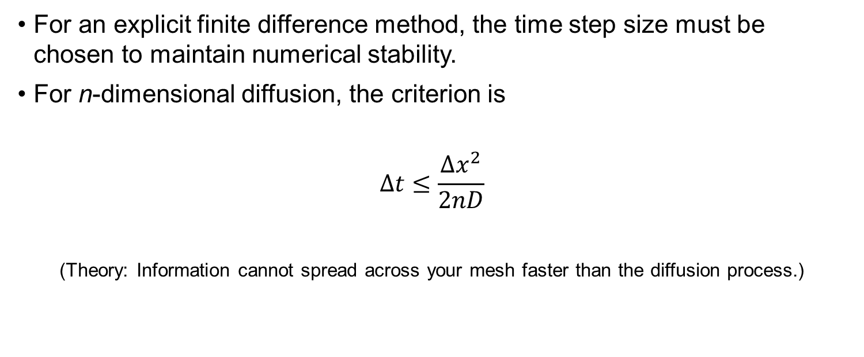
A word on stability
For an explicit finite difference method, the time step size must be chosen to maintain numerical stability.
For n-dimensional diffusion, the criterion is
$$Δt≤\frac{Δx^{2}}{2nD}$$
(Theory: Information cannot spread across your mesh faster than the diffusion process.)

Slide 23
Testing …
# declare an environment
E = Environment( [-250,-250,250,250] , 26,26 )
# set up
E.setup( 10000, 1 , 0.5 , 1 )
dt = E.dx**2 / (2 * 2 * E.D )
print(dt)
# main test loop
for n in range(100):
if( n % 20 == 0 ):
E.plot()
plt.show()
E.update( dt )
E.plot()
Go to the Lecture notebook (Section 4) to execute this code.

Slide 24
Creating a Cell class (v1)
Let's iteratively create and refine a Cell class.
The first version will add a constructor and basic cell-cell mechanics
Each cell will interact with nearby cells
We'll use a spring-like force to model the combined effects of adhesion and repulsion
We'll assume dissipative (drag-like) forces lead to fast equilibration, allowing us to solve for the cell velocity.

Slide 25
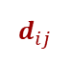
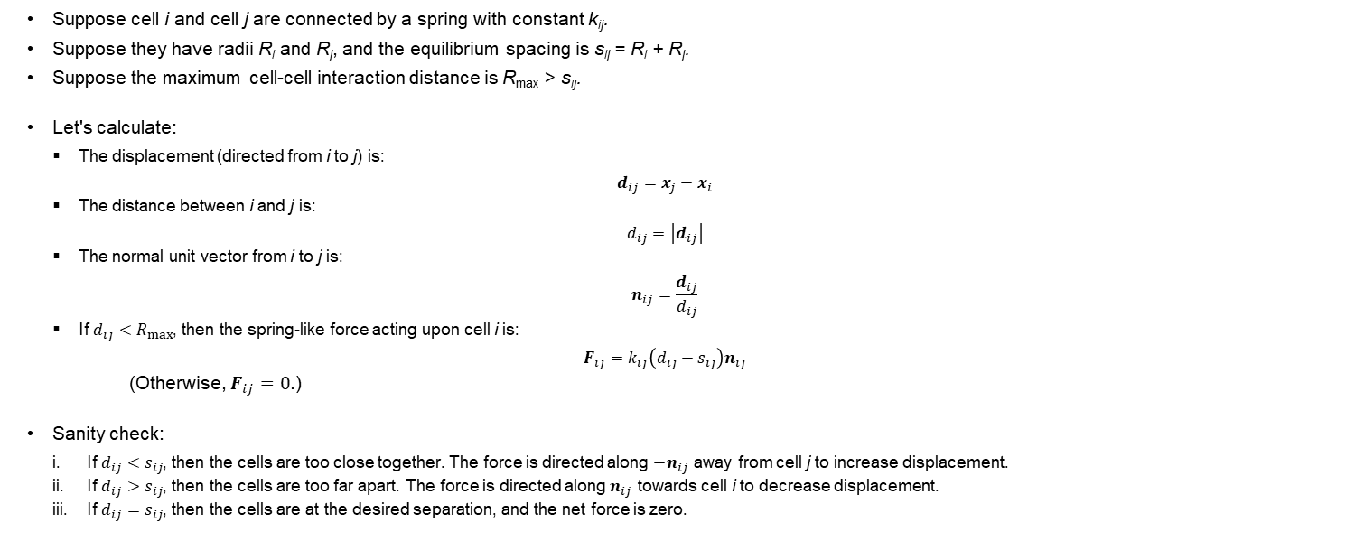
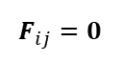

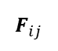
Cell velocities: math (1)
cell j
Suppose cell i and cell j are connected by a spring with constant k_{ij}.
Suppose they have radii R_{i} and R_{j}, and the equilibrium spacing is s_{ij} = R_{i} + R_{j}.
Suppose the maximum cell-cell interaction distance is R_{max} > s_{ij}.
Let's calculate:
The displacement (directed from i to j) is:
$$d_{ij}=x_{j}−x_{i}$$
The distance between i and j is:
$$d_{ij}=\left|d_{ij}\right|$$
The normal unit vector from i to j is:
$$n_{ij}=\frac{d_{ij}}{d_{ij}}$$
If $d_{ij}<R_{max}$, then the spring-like force acting upon cell i is:
$$F_{ij}=k_{ij}\left(d_{ij}−s_{ij}\right)n_{ij}$$
(Otherwise, $F_{ij}=0$.)
Sanity check:
If $d_{ij}<s_{ij}$, then the cells are too close together. The force is directed along ${−n}_{ij}$ away from cell j to increase displacement.
If $d_{ij}>s_{ij}$, then the cells are too far apart. The force is directed along $n_{ij}$ towards cell i to decrease displacement.
If $d_{ij}=s_{ij}$, then the cells are at the desired separation, and the net force is zero.
i.
$$F_{ij}$$
$$d_{ij}$$
cell i
cell j
$$F_{ij}$$
ii.
$$d_{ij}$$
cell i
cell j
iii.
$$d_{ij}$$
cell i
$$F_{ij}=0$$

Slide 26
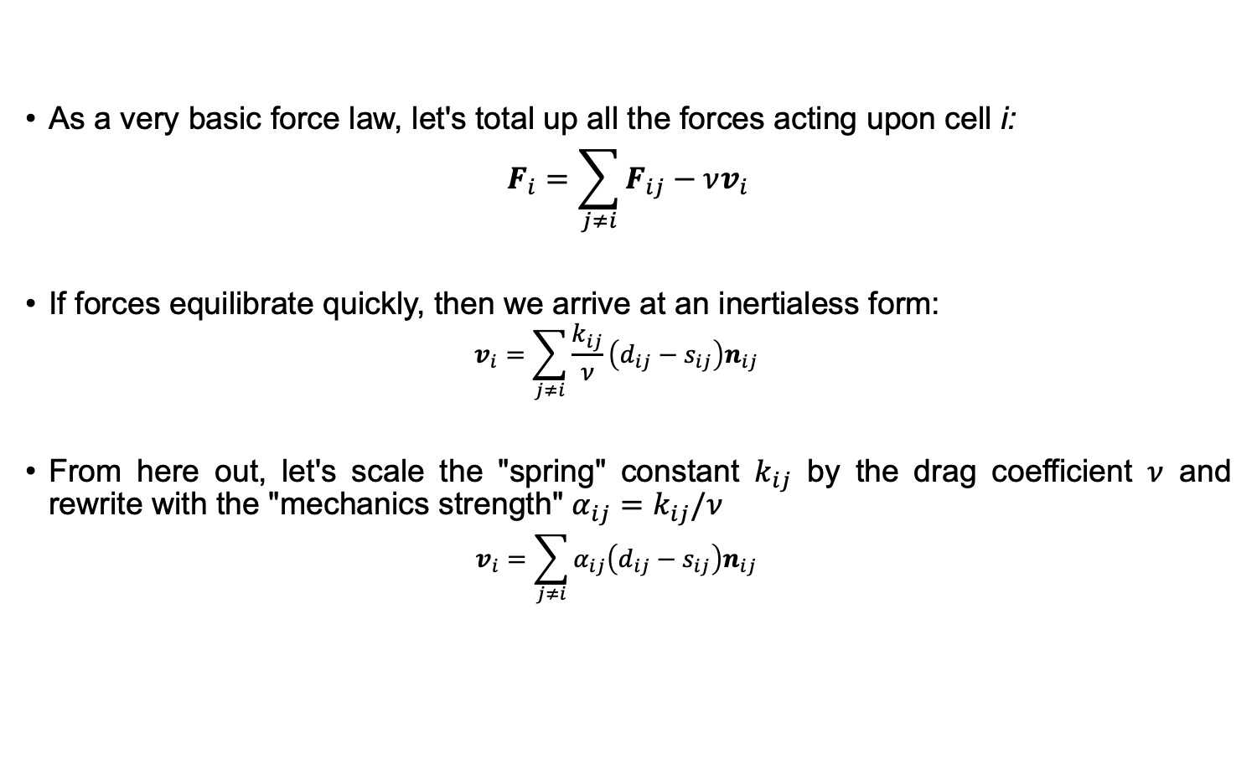
Cell velocities: math (2)
As a very basic force law, let's total up all the forces acting upon cell i:
$$F_{i}=\sum_{j≠i}{F_{ij}}−νv_{i}$$
If forces equilibrate quickly, then we arrive at an inertialess form:
$$v_{i}=\sum_{j≠i}{\frac{k_{ij}}{ν}\left(d_{ij}−s_{ij}\right)n_{ij}}$$
From here out, let's scale the "spring" constant $k_{ij}$ by the drag coefficient $ν$ and rewrite with the "mechanics strength" $α_{ij}=k_{ij}/ν$
$$v_{i}=\sum_{j≠i}{α_{ij}\left(d_{ij}−s_{ij}\right)n_{ij}}$$

Slide 27
Creating a Cell class (v1)
all_cells = list();
class Cell:
def __init__( self ):
self.position = np.array( [0.0,0.0] );
self.velocity = np.array( [0,0] );
self.mechanics_distance = 30;
self.equilibrium_spacing = 20;
self.mechanics_contant = 1;
def update_velocity( self, dt , env , all_cells ):
self.velocity = np.array([0,0])
# spring-like interactions with cells
for c in all_cells:
displacement = c.position - self.position
dist = np.linalg.norm( displacement )
if( dist < self.mechanics_distance and dist > 1e-16 ):
dv = dist - self.equilibrium_spacing
displacement = displacement / dist;
displacement = displacement * dv;
displacement = displacement * self.mechanics_contant;
self.velocity = self.velocity + displacement
angle = 6.28318530718 * np.random.uniform();
perturbation_size = 0.1 * self.mechanics_contant;
self.velocity[0] += perturbation_size * np.cos(angle)
self.velocity[1] += perturbation_size * np.sin(angle)
def update_position( self, dt , env, all_cells ):
self.position = self.position + dt*self.velocity;
Go to the Lecture notebook (Section 5) to execute this code.

Slide 28
Testing (part 1)
all_cells = list()
# make a plotting function
def plot_cells( env, all_cells ):
plt.clf()
for c in all_cells:
plt.plot( c.position[0] , c.position[1] , 'ko')
plt.axis('image')
# plt.axis( [env.a, env.b, env.c, env.d])
return;
# now make 10 cells with random positions
number_of_cells = 10;
center = [ 0.5*(E.a+E.b) , 0.5*(E.c+E.d)]
for n in range(number_of_cells):
c = Cell(); # create cell.
r = 5 * np.random.normal();
angle = 6.28318530718 * np.random.uniform();
c.position[0] = center[0] + r * np.cos(angle)
c.position[1] = center[1] + r * np.sin(angle)
all_cells.append(c)
plot_cells( E, all_cells )
Go to the Lecture notebook (Section 5) to execute this code.

Slide 29
Testing (part 2)
dt = 0.1
for n in range( 1000 ):
for c in all_cells:
c.update_velocity( dt , E, all_cells )
for c in all_cells:
c.update_position( dt , E, all_cells )
if( n % 100 == 0 ):
plot_cells( E, all_cells )
plt.show()
Go to the Lecture notebook (Section 5) to execute this code.

Slide 30
Cell class (v2)
Now, we add division and death methods.
Division will make a copy of the cell and add it to a list of all cells
Death will remove the cell from the list of all cells and delete it

Slide 31
Cell class (v2)
class Cell:
# __init__, update_velocity, and update_position as before
def division( self, all_cells ):
# make a brand new cell
c = copy.deepcopy( self );
# append it to the data structure
all_cells.append( c );
# set its position to be near its parent cell
r = self.equilibrium_spacing;
angle = np.random.uniform()
c.position[0] = r*np.cos(angle)
c.position[1] = r*np.sin(angle)
return;
def death( self, all_cells ):
all_cells.remove( self )
del self;
Go to the Lecture notebook (Section 6) to execute this code.

Slide 32
Testing …
all_cells.clear()
# now make 10 cells with random positions
number_of_cells = 10;
center = [ 0.5*(E.a+E.b) , 0.5*(E.c+E.d)]
for n in range(number_of_cells):
c = Cell(); # create cell.
r = 5 * np.random.normal();
angle = 6.28318530718 * np.random.uniform();
c.position[0] = center[0] + r * np.cos(angle)
c.position[1] = center[1] + r * np.sin(angle)
all_cells.append(c)
plot_cells( E, all_cells )
dt = 0.1;
for n in range( 1000 ):
for c in all_cells:
c.update_velocity( dt , E, all_cells )
for c in all_cells:
c.update_position( dt , E, all_cells )
if( n % 50 == 0 ):
n_cells = len( all_cells )
n_divide = np.random.randint( n_cells );
all_cells[n_divide].division( all_cells )
if( n % 200 == 0 ):
n_cells = len( all_cells )
n_die = np.random.randint( n_cells );
all_cells[n_die].death( all_cells )
if( n % 100 == 0 ):
plot_cells( E, all_cells )
plt.show()
Go to the Lecture notebook (Section 6) to execute this code.

Slide 33
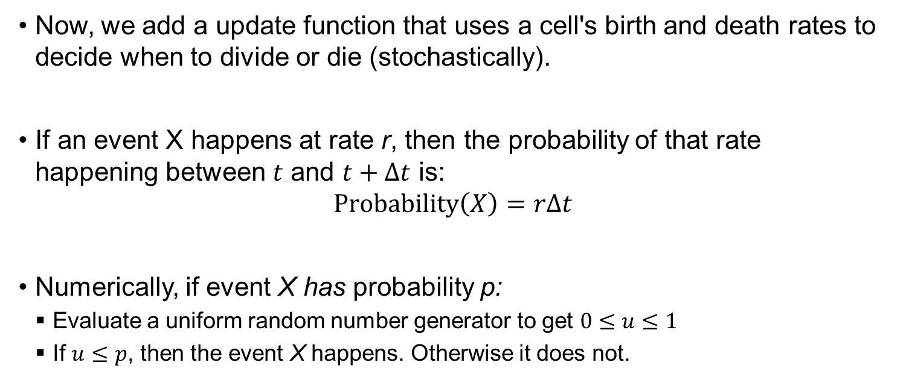
Cell class (v3)
Now, we add a update function that uses a cell's birth and death rates to decide when to divide or die (stochastically).
If an event X happens at rate r, then the probability of that rate happening between $t$ and $t+Δt$ is:
$$Probability\left(X\right)=rΔt$$
Numerically, if event X has probability p:
Evaluate a uniform random number generator to get $0≤u≤1$
If $u≤p$, then the event X happens. Otherwise it does not.

Slide 34
Cell class (v3)
class Cell:
def __init__( self ):
#mostly same, but add these
self.birth_rate = 0.01;
self.death_rate = 0.005;
# udpate_velocity, update_position, division, and death as before
def update( self, dt, env, all_cells ):
prob_birth = self.birth_rate * dt;
prob_death = self.death_rate * dt;
if( np.random.uniform() <= prob_birth ):
self.division( all_cells );
return;
if( np.random.uniform() <= prob_death ):
self.death( all_cells );
return;
return;
Go to the Lecture notebook (Section 7) to execute this code.

Slide 35
Testing …
all_cells.clear()
# now make 10 cells with random positions
number_of_cells = 10;
center = [ 0.5*(E.a+E.b) , 0.5*(E.c+E.d)]
for n in range(number_of_cells):
c = Cell(); # create cell.
r = 5 * np.random.normal();
angle = 6.28318530718 * np.random.uniform();
c.position[0] = center[0] + r * np.cos(angle)
c.position[1] = center[1] + r * np.sin(angle)
all_cells.append(c)
plot_cells( E, all_cells )
dt = 0.1;
for n in range( 1000 ):
for c in all_cells:
c.update( dt , E, all_cells );
for c in all_cells:
c.update_velocity( dt , E, all_cells )
for c in all_cells:
c.update_position( dt , E, all_cells )
if( n % 100 == 0 ):
plot_cells( E, all_cells )
plt.show()
Go to the Lecture notebook (Section 7) to execute this code.

Slide 36
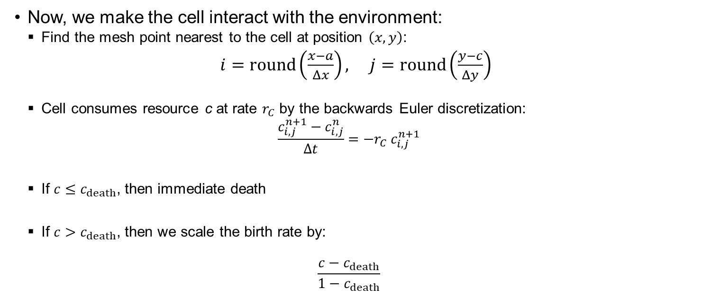
Cell class (v4)
Now, we make the cell interact with the environment:
Find the mesh point nearest to the cell at position $\left(x,y\right)$:
$i=round\left(\frac{x−a}{Δx}\right), j=round\left(\frac{y−c}{Δy}\right)$
Cell consumes resource c at rate $r_{C}$ by the backwards Euler discretization:
$$\frac{c_{i,j}^{n+1}−c_{i,j}^{n}}{Δt}=−r_{C}{ c}_{i,j}^{n+1}$$
If $c≤c_{death}$, then immediate death
If $c>c_{death}$, then we scale the birth rate by:
$$\frac{c−c_{death}}{1−c_{death}}$$

Slide 37
Cell class (v4)
class Cell:
def __init__( self ):
# add these
self.death_threshold = 0.3;
self.consumption_rate = 1;
# update_velocity and update_position unchanged
def update( self, dt, env, all_cells ):
# find my coordinates in the environment
i = np.int( np.round( (self.position[0]-env.a)/env.dx ) );
j = np.int( np.round( (self.position[1]-env.c)/env.dy ) );
# consume substrate (backwards Euler)
constant = 1.0 + dt*self.consumption_rate;
env.C[i,j] /= constant;
# update birth and death rates based on C
substrate = env.C[i,j]
birth_rate = self.birth_rate * (substrate - self.death_threshold)/(1-self.death_threshold);
death_rate = self.death_rate;
if( birth_rate < 0 ):
birth_rate = 0.0;
if( env.C[i,j] < self.death_threshold ):
self.death(all_cells)
return;
prob_birth = birth_rate * dt;
prob_death = death_rate * dt;
if( np.random.uniform() <= prob_birth ):
self.division( all_cells );
return;
if( np.random.uniform() <= prob_death ):
self.death( all_cells );
return;
return;
Go to the Lecture notebook (Section 8) to execute this code.

Slide 38
New plotting function
# make a plotting function
def plot( env, all_cells ):
plt.figure(1 , figsize=(10,10) )
plt.clf()
env.plot()
for c in all_cells:
plt.plot( c.position[0] , c.position[1] , 'ko' , markersize=10 ,
markerfacecolor='w' , alpha=0.5)
plt.axis('image')
plt.axis( [env.a, env.b, env.c, env.d])
plt.title('number of cells: ' + str(len(all_cells)) )
return;
Go to the Lecture notebook (Section 8) to execute this code.

Slide 39
Testing …
all_cells.clear()
E.setup( 10000, 0.001 , 1 , 1 )
# now make 25 cells with random positions
number_of_cells = 25;
center = [ 0.5*(E.a+E.b) , 0.5*(E.c+E.d)]
for n in range(number_of_cells):
c = Cell(); # create cell.
r = 50 * np.random.normal();
angle = 6.28318530718 * np.random.uniform();
c.position[0] = center[0] + r * np.cos(angle)
c.position[1] = center[1] + r * np.sin(angle)
all_cells.append(c)
plot( E, all_cells )
dt = 0.1;
for n in range( 2000 ):
for nn in range(10):
E.update( 0.1*dt )
for c in all_cells:
c.update( dt , E, all_cells );
for c in all_cells:
c.update_velocity( dt , E, all_cells )
for c in all_cells:
c.update_position( dt , E, all_cells )
if( n % 200 == 0 ):
plot( E, all_cells )
plt.show()
Go to the Lecture notebook (Section 8) to execute this code.

Slide 40
Next time:
Introduce PhysiCell as a more developed agent-based platform.
Show examples of agent-based PhysiCell modeling in research.
Explore cloud-hosted models.

Slide 41
Further reading (1)
BioFVM method paper (3-D diffusion)
A. Ghaffarizadeh, S.H. Friedman, and P. Macklin. BioFVM: an efficient, parallelized diffusive transport solver for 3-D biological simulations. Bioinformatics 32(8):1256-8, 2016. DOI: 10.1093/bioinformatics/btv730.
PhysiCell method paper (agent-based model)
A. Ghaffarizadeh, R. Heiland, S.H. Friedman, S.M. Mumenthaler, and P. Macklin. PhysiCell: an open source physics-based cell simulator for 3-D multicellular systems. PLoS Comput. Biol. 14(2):e1005991, 2018. DOI: 10.1371/journal.pcbi.1005991.
PhysiBoSS (PhysiCell + MaBoSS for Boolean networks)
G. Letort, A. Montagud, G. Stoll, R. Heiland, E. Barillot, P. Macklin, A. Zinovyev, and L. Calzone. PhysiBoSS: a multi-scale agent based modelling framework integrating physical dimension and cell signalling. Bioinformatics 35(7):1188-96, 2019. DOI: 10.1093/bioinformatics/bty766.
xml2jupyter paper (create GUIs for cloud-hosted models)
R. Heiland, D. Mishler, T. Zhang, E. Bower, and P. Macklin. xml2jupyter: Mapping parameters between XML and Jupyter widgets. Journal of Open Source Software 4(39):1408, 2019. DOI: 10.21105/joss.01408.
PhysiCell+EMEWS (high-throughput 3D PhysiCell investigation)
J. Ozik, N. Collier, J. Wozniak, C. Macal, C. Cockrell, S.H. Friedman, A. Ghaffarizadeh, R. Heiland, G. An, and P. Macklin. High-throughput cancer hypothesis testing with an integrated PhysiCell-EMEWS workflow. BMC Bioinformatics 19:483, 2018. DOI: 10.1186/s12859-018-2510-x.
PhysiCell+EMEWS 2 (HPC accelerated by machine learning)
J. Ozik, N. Collier, R. Heiland, G. An, and P. Macklin. Learning-accelerated Discovery of Immune-Tumour Interactions. Molec. Syst. Design Eng. 4:747-60, 2019. DOI: 10.1039/c9me00036d.

Slide 42
Further reading (2)
A review of cell-based modeling (in cancer):
J. Metzcar, Y. Wang, R. Heiland, and P. Macklin. A review of cell-based computational modeling in cancer biology. JCO Clinical Cancer Informatics 3:1-13, 2019 (invited review). DOI: 10.1200/CCI.18.00069.
Progress on multicellular systems biology:
P. Macklin, H.B. Frieboes, J.L. Sparks, A. Ghaffarizadeh, S.H. Friedman, E.F. Juarez, E. Jockheere, and S.M. Mumenthaler. "Progress Towards Computational 3-D Multicellular Systems Biology". In: . Rejniak (ed.), Systems Biology of Tumor Microenvironment, chap. 12, pp. 225-46, Springer, 2016. ISBN: 978-3-319-42021-9. (invited author: P. Macklin). DOI: 10.1007/978-3-319-42023-3_12.
Challenges for data-driven multicellular systems biology
P. Macklin. Key challenges facing data-driven multicellular systems biology. GigaScience 8(10):giz127, 2019. DOI: 10.1093/gigascience/giz127

Slide 43
Some models to explore
On nanoHUB:
pc4heterogen: heterogeneous cancer growth (https://nanohub.org/tools/pc4heterogen)
pc4cancerbots: use the "biorobots" as a cell-based cancer therapy (https://nanohub.org/tools/pc4cancerbots)
pc4cancerimmune: basic cancer immunotherapy model (https://nanohub.org/tools/pc4cancerimmune)
trmotility: learn about biased random cell migration (https://nanohub.org/tools/trmotility)
pcisa: learn about an adversarial ecosystem: invader cells are fueled by resource providers, but scout cells seek invaders to recruit attackers, who poison invaders. (https://nanohub.org/tools/pcisa)
pc4thanos: Avengers Endgame battle using cell rules (https://nanohub.org/tools/pc4thanos)
pc4covid19: COVID-19 simulation model (https://nanohub.org/tools/pc4covid19)
pc4livermedium: tumor-stroma biomechanical feedbacks (https://nanohub.org/tools/pc4livermedium)

